Slide 1

HR Analytics of Employee Attrition & Performance

Slide 2



Team members
NITISH
SANITH PS
SACHIN VILAS NAGANE

Slide 3
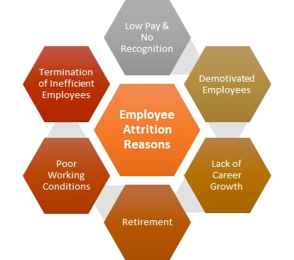
What is eMPLOYEE aTTrition ?

Slide 4
ABSTRACT
Predicting the Employee Attrition as well as analysing their Performance with the help of Machine Learning Models using the available datasets in order to facilitate the work of the HR of a company so that they could improve their employees working efficiency & also reduce their attrition rate

Slide 5
OBJECTIVE
Identifying the significant reasons for Employee Attrition in the Company
Analysing the Performance of the Employee
Improving the working Conditions and other factors which affects the employees working efficiency
Creating a user friendly model to predict whether an employee is likely to quit the job or not
Reducing the Employee Atttrition Rate
Increasing the HR’s ability to intervene on time and find a remedy for the situation
Finally…Contributing towards overall development of the company

Slide 6
DATASet USED
IBM Employee Attrition Dataset
Consists the attrition data of 1470 Employees
Number of Features used : 35
Target Feature : Attrition

Slide 7
PRoPOSED SYSTEM
It can be used to help the human resource department of the company to identify the most significant reasons for employee attrition
It can be used to predict whether a particular employee would leave the company or who might be the next to leave the company

Slide 8
LIMITATIONS
The most preferred model has only 88 % testing accuracy.
The processing speed of the model is somewhat slow.

Slide 9
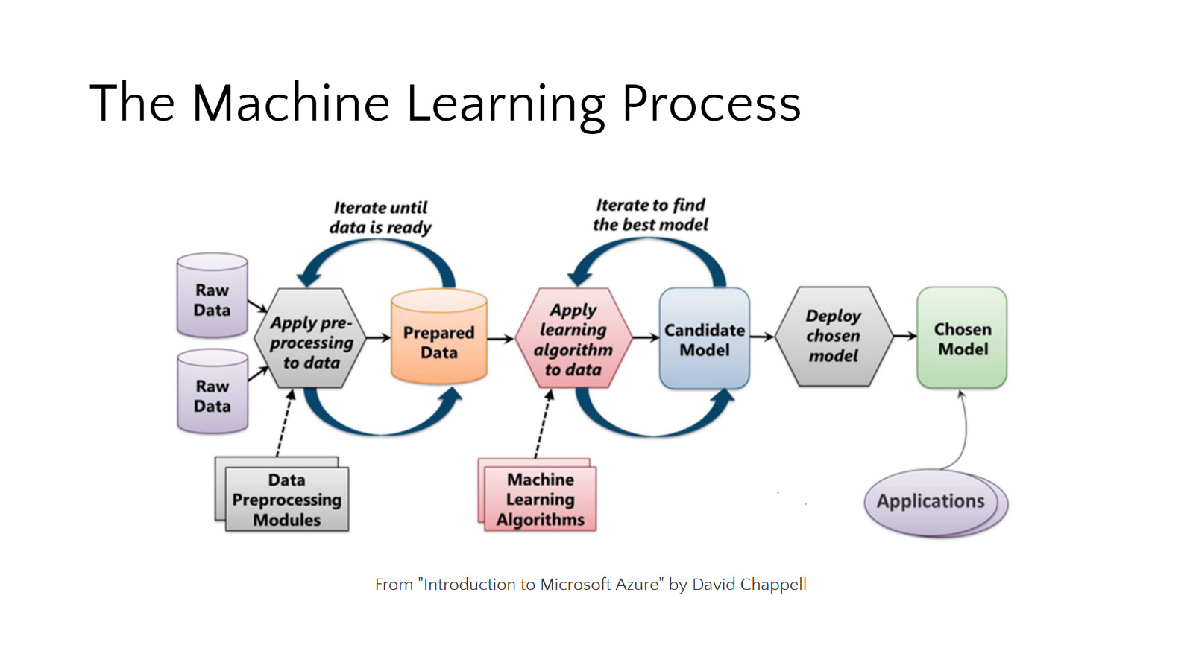
Architecture & MODULES USED

Slide 10
Exploratory data analysis
Model development & evaluation
GUI development
Libraries Used
Numpy
Pandas
Matplotlib
Seaborn
Scikit Learn
ML Algorithms Implemented
Logistic Regression
Support Vector Machines
K Nearest Neighbours
Decision Tree
K Means Clustering
Tools Used
Tkinter

Slide 11
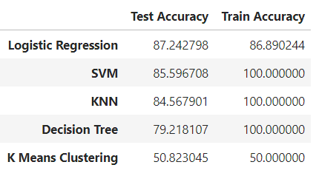
ACCURACY COMPARISON

Slide 12
GUI USING TKINTER

Slide 13
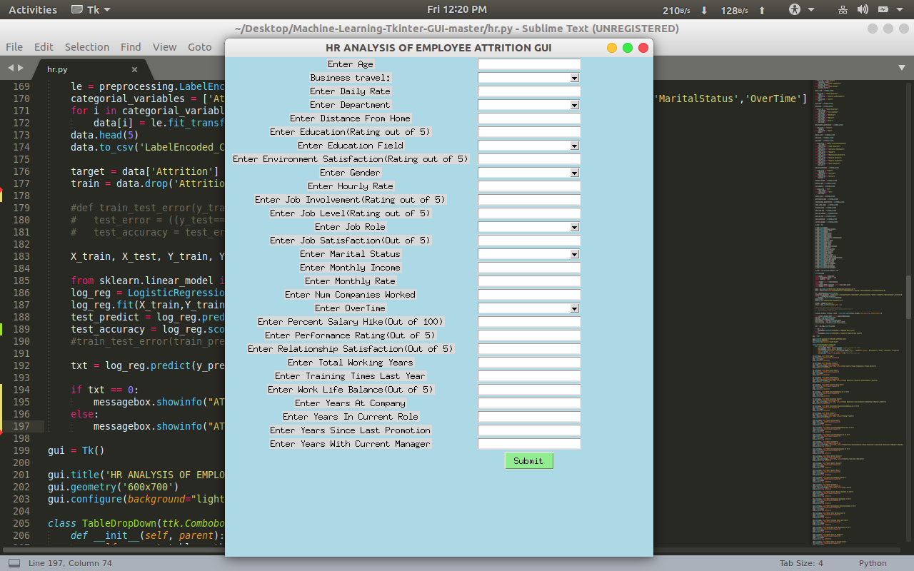

Slide 14
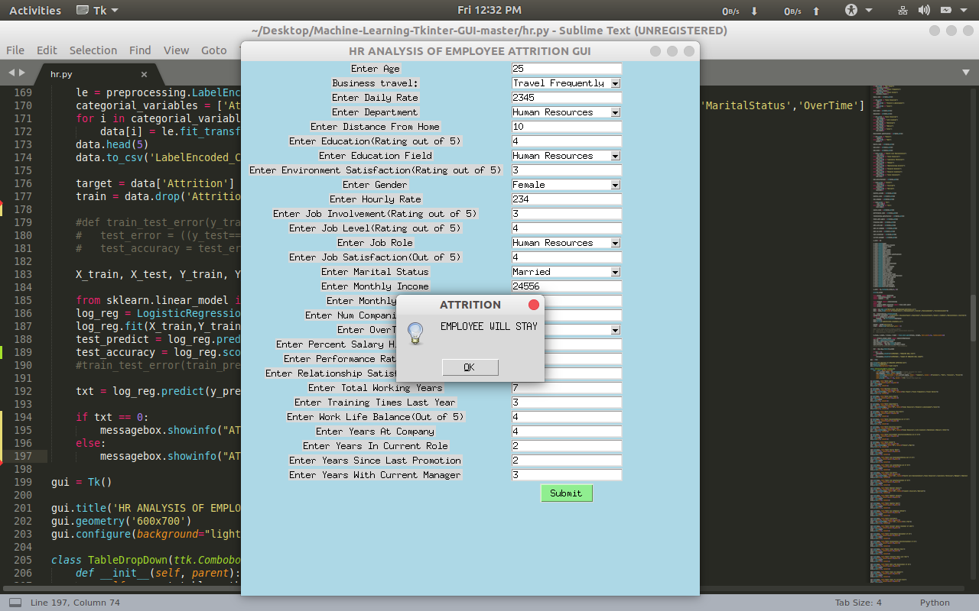

Slide 15
Thank You!

